Slide 1
Epidemiology, Control and Prevention of Infection
Prof dr Ismail Ibrahim Latif

Slide 2
EPIDEMIOLOGY OF INFECTION:
The potential of infectious diseases for transmission means that, once a clinician has diagnosed an infectious disease, potential exposure of other patients must be considered.
The patient may require treatment in isolation, or an outbreak of disease may need to be investigated in the community.

Slide 3
Geographic and temporal patterns of infection:
Endemic disease:
Endemic disease has a constant presence within a given geographic area or population.
The infectious agent may have a reservoir, vector or intermediate host that is geographically restricted, or may itself have restrictive environmental requirements (e.g. temperature range, humidity).

Slide 4
The population affected may be geographically isolated, or the disease may be limited to unvaccinated populations.

Slide 5
Factors that alter geographical restriction include:
• expansion of an animal reservoir (e.g. Lyme disease from reforestation)
• vector escape (e.g. airport malaria)
• extension of host range (e.g. schistosomiasis from dam construction)
• human migration (e.g. HIV)
• public health service breakdown (e.g. diphtheria in unvaccinated areas)
• climate change.

Slide 6
Emerging and re-emerging disease:
An emerging infectious disease is one that has newly appeared in a population, or that has been known for some time but is rapidly increasing in incidence or geographic range.
If the disease was previously known and thought to have been controlled or eradicated, it is considered to be re-emerging.

Slide 7
Emergence may result from an organism adapting to cause a truly ‘new’ disease or escaping from a pre-existing restriction.
Many emerging diseases are caused by organisms which infect animals and have undergone adaptations that enable them to infect humans.
This is exemplified by HIV, which is believed to have originated in higher primates in Africa.

Slide 8
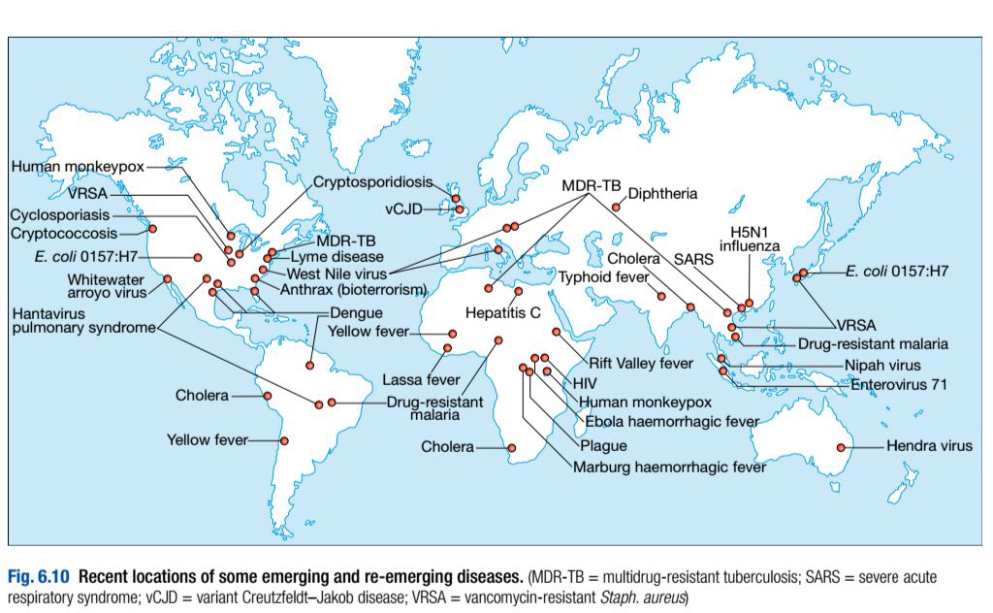

Slide 9
Reservoirs of infection:
The US Centers for Disease Control (CDC) define a reservoir of infection as ‘one or more epidemiologically connected populations or environments in which a pathogen can be permanently maintained, and from which infection is transmitted to a defined target population’.
Reservoirs of infection may be human, animal or environmental.

Slide 10
a. Human reservoirs:
Colonised individuals or those with clinical infectious disease may act as reservoirs, e.g. for Staph. aureus (including MRSA), which is carried in the nares of 30–40% of humans, and C. difficile.

Slide 11
For infected humans to act as reservoirs, the infections caused must be long-lasting and/or non-fatal, at least in a proportion of those affected, to enable onward transmission (e.g. tuberculosis, typhoid and sexually transmitted infections).
Humans are the only reservoir for some organisms (e.g. smallpox and measles).

Slide 12
b. Animal reservoirs:
The World Health Organisation (WHO) defines a zoonosis as ‘a disease or infection that is naturally transmissible from vertebrate animals to humans’.
The infection may be asymptomatic in the animal.
Primary infection with zoonoses may on rare occasions be transmitted onward between humans by sexual contact (e.g. Q fever, brucellosis, Marburg, Ebola), causing secondary disease.

Slide 13
c. Environmental reservoirs:
Many infective pathogens are acquired from an environmental source.
However, some of these are maintained in human or animal reservoirs, with the environment acting simply as a conduit for infection.

Slide 14
Transmission of infection:
Infectious agents may be transmitted by multiple routes:
•The respiratory route refers to acquisition of infection by inhalation.
•The faecal–oral route describes acquisition by ingestion of infectious material originating from faecal matter.
•Sexually transmitted infections are acquired by direct contact between mucous membranes.
•Blood-borne infections are transmitted by direct inoculation of infected blood or body fluids.

Slide 15
• Direct contact: Very few organisms are capable of causing infection by direct contact with intact skin. Most infection by this route requires inoculation or contact with damaged skin.

Slide 16
In many infections there is an intermediary, which bridges the gap between the infected host (or the reservoir) and the uninfected host.
• If the intermediary is animate it is known as a vector(e.g. mosquitoes in malaria and dengue, fleas in plague, humans in MRSA).
• Inanimate intermediaries are known as fomites, and are particularly associated with health care-associated infection, where fomites include door handles, water taps, ultrasound probes etc.

Slide 17
The likelihood of infection following transmission of an infectious agent depends on both organism factors and host susceptibility.
The numbers of organisms required to cause infection or death in 50% of the exposed population are referred to as the ID₅₀ (infectious dose) and LD₅₀ (lethal dose), respectively.

Slide 18
The incubation period is the time between exposure and development of disease, and the period of infectivity is the period after exposure during which the patient is infectious to others.

Slide 19
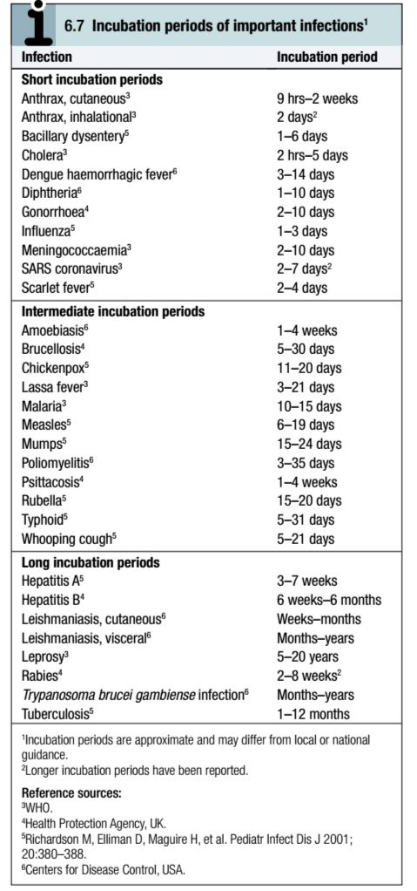
Knowledge of incubation periods and periods of infectivity is important in controlling the spread of disease.

Slide 20
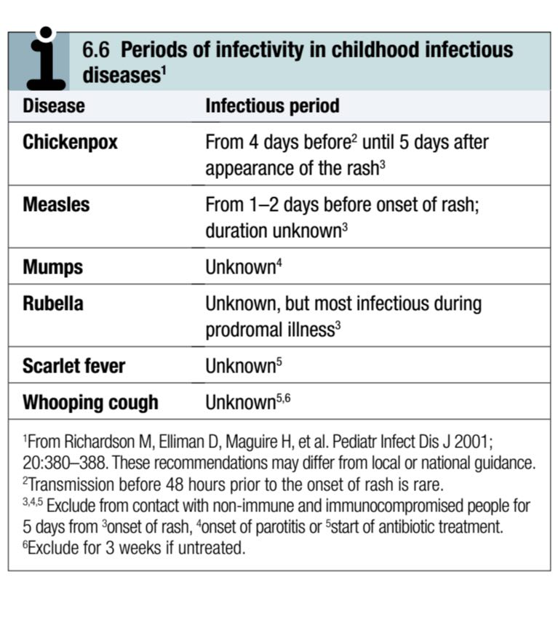

Slide 21
:Bioterrorism and deliberate release
Infectious agents may be released or transmitted deliberately with the intention of causing disease.
The large-scale use of microorganisms for this purpose is known as biological warfare or bioterrorism, depending on the context.

Slide 22
Deliberate-release incidents have included a 750-person outbreak of Salmonella typhimurium by deliberate contamination of salads in 1984 (Oregon, USA) and 22 cases of anthrax (five fatal) from the mailing of finely powdered (weaponised) anthrax spores in 2001 (New Jersey, USA).

Slide 23
Diseases with high potential for use in bioterrorism include anthrax, plague, tularaemia, smallpox and botulism (through toxin release).

Slide 24
CONTROL AND PREVENTION OF :INFECTION
Infection prevention and control (IPC) describes the measures applied to populations with the aim of breaking the chain of infection.

Slide 25
Health care-acquired infection:
Admission to a health-care facility in the developed world carries a considerable risk of acquiring infection, estimated by the UK Department of Health as 6–10%.

Slide 26
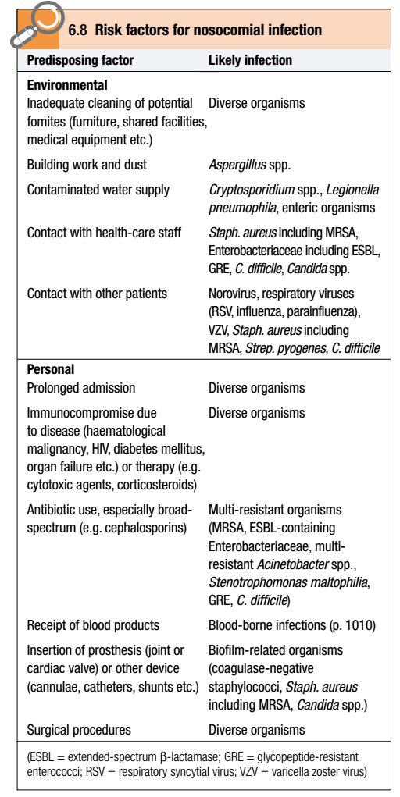
The factors that contribute to health care-acquired (nosocomial) infection in an individual patient :

Slide 27
Many nosocomial bacterial infections are caused by organisms that are resistant to numerous antibiotics (multi-resistant bacteria), including methicillin-resistant Staph. aureus (MRSA), extended-spectrum β-lactamase (ESBL)-producing Enterobacteriaceae and glycopeptide-resistant enterococci (GRE).
Other infections of particular concern in hospitals include C. difficile and norovirus.

Slide 28
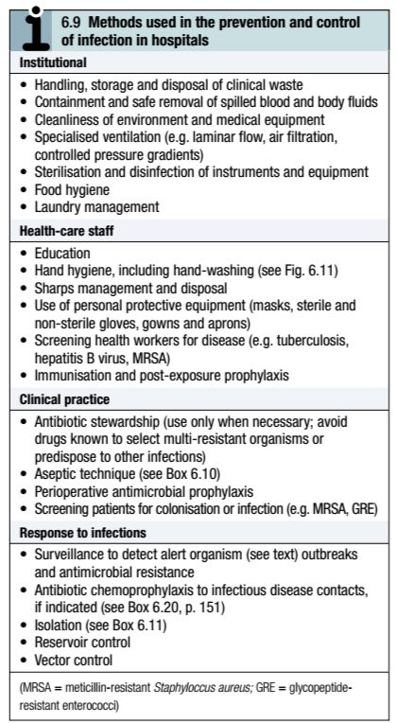
IPC measures:

Slide 29
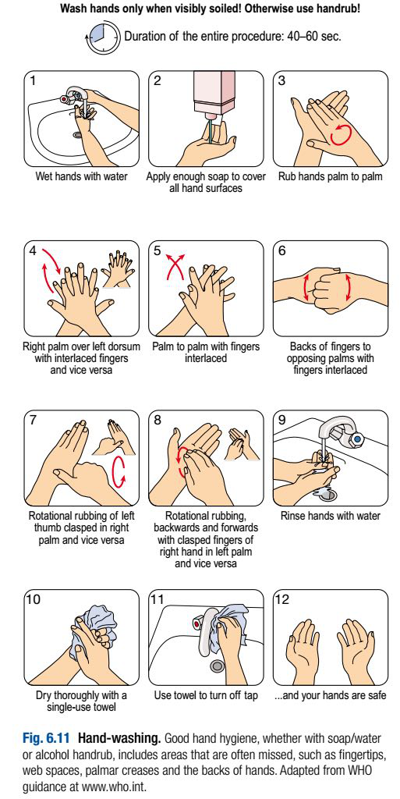
The most important infection control practice is maintenance of good hand hygiene.

Slide 30
Hand decontamination or washing is mandatory before and after every patient contact.
In most cases, decontamination with alcohol gel is adequate.
However, hand-washing (with hot water, liquid soap and complete drying) is required after undertaking any procedure that involves more than casual physical contact, or if hands are visibly soiled.

Slide 31
In situations where the prevalence of C. difficile is high (e.g. a local outbreak), alcohol gel decontamination between patient contacts is inadequate, as it does not kill C. difficile spores, and hands must be washed with soap and water.

Slide 32
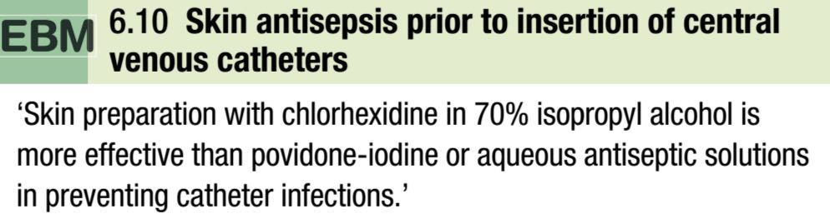
To avoid infection, all invasive procedures must be performed with strict aseptic technique.

Slide 33
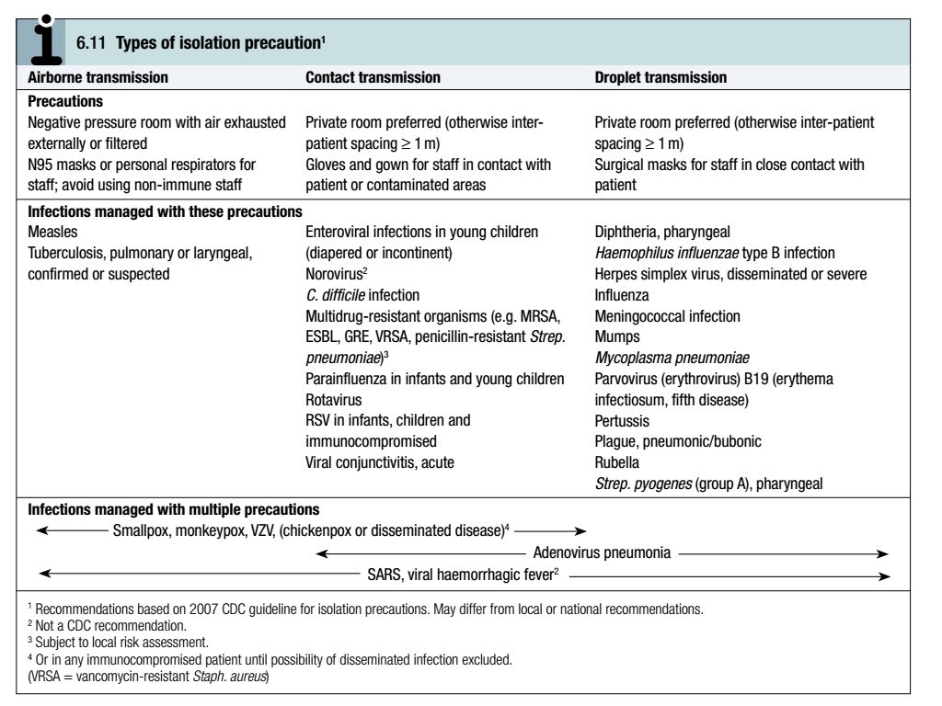
Some infections necessitate additional measures to prevent cross-infection:

Slide 34
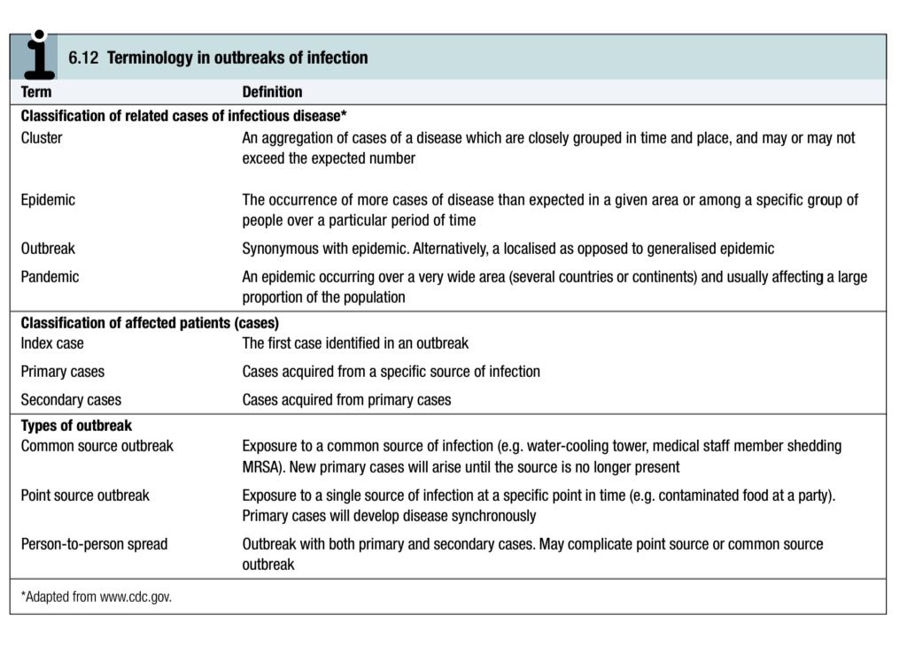
Outbreaks of infection:

Slide 35
Confirmation of an infectious disease outbreak usually requires evidence from typing that the causal organisms have identical genotypic characteristics.
If this is found not to be the case, the term pseudo-outbreak is used.
When an outbreak of infection is suspected, a case definition is agreed.

Slide 36
The number of cases that meet the case definition is then assessed by case finding, using methods ranging from administration of questionnaires to national reporting systems.
Case finding usually includes microbiological testing, at least in the early stages of an outbreak.

Slide 37
Temporal changes in cases are noted to plot an outbreak curve, and demographic details are collected to identify possible sources of infection.

Slide 38
A case control study, in which recent activities (potential exposures) of affected ‘cases’ are compared to those of unaffected ‘controls’, may be undertaken to establish the outbreak source, and measures are taken to manage the outbreak and control its spread.

Slide 39
Good communication between relevant personnel during and after the outbreak is important to inform practice in future outbreaks.
Surveillance ensures that disease outbreaks are either pre-empted or identified early.

Slide 40
In hospitals, staff are alerted to the isolation of alert organisms, which have the propensity to cause outbreaks, and alert conditions (infectious diseases), which are likely to be caused by such organisms.
Similar systems are used nationally; many countries publish lists of organisms and diseases which, if detected (or suspected), must be reported to public health authorities.

Slide 41
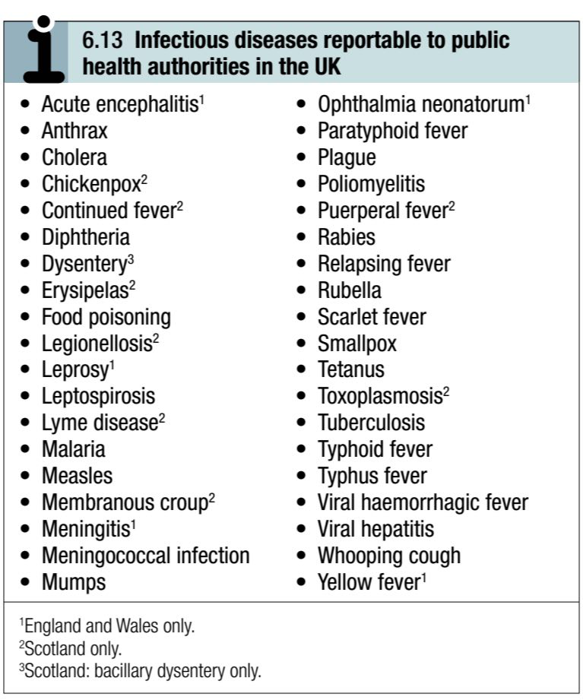

Slide 42
Principles of food hygiene:
‘Food poisoning’ is largely preventable by food hygiene measures.
The main principles are:
•segregation of uncooked food (which may be contaminated with pathogenic microorganisms) from cooked food during storage, handling and preparation
•avoidance of conditions which allow growth of pathogenic bacteria before or after cooking
• adequate bacterial killing during cooking.

Slide 43
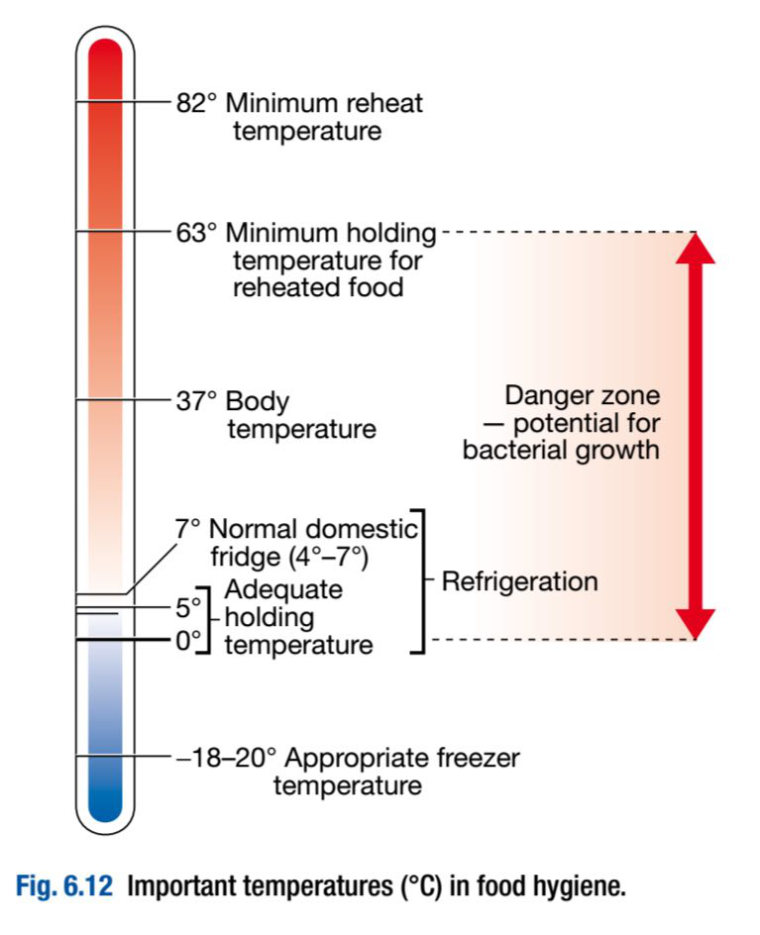
Safe storage requires knowledge of the temperatures at which food bacteria are inhibited and destroyed:

Slide 44
Immunization:
Immunization may be passive or active.
Passive immunization is achieved by administering antibodies targeted against a specific pathogen.
Antibodies are obtained from human blood, so confer some of the risks associated with blood products.

Slide 45
The protection afforded by passive immunisation is immediate but of short duration (a few weeks or months); it is used to prevent or attenuate infection before or after exposure.

Slide 46
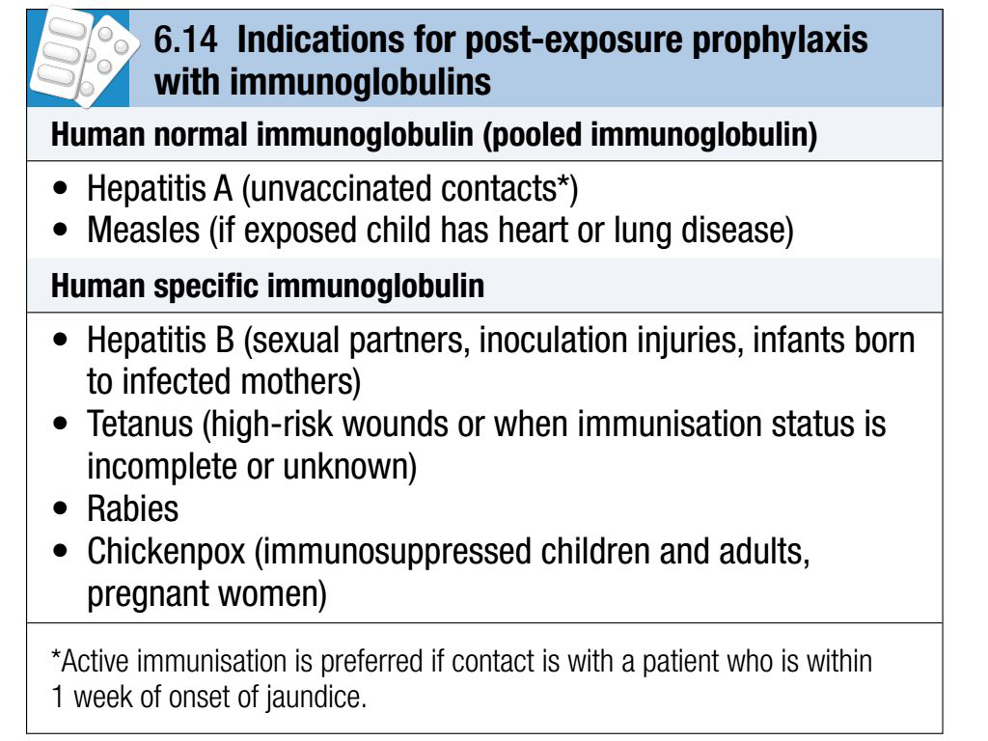

Slide 47
Vaccination:
Active immunization is achieved by vaccination with entire organisms or antigenic components such as proteins and polysaccharides.
DNA vaccines are also under investigation.

Slide 48
Desirable vaccine attributes include:
• minimal vaccine-related adverse effects
•a high level of immunity (i.e. few vaccine failures)
• long-lasting protection
• minimal cost
• ease of delivery.

Slide 49
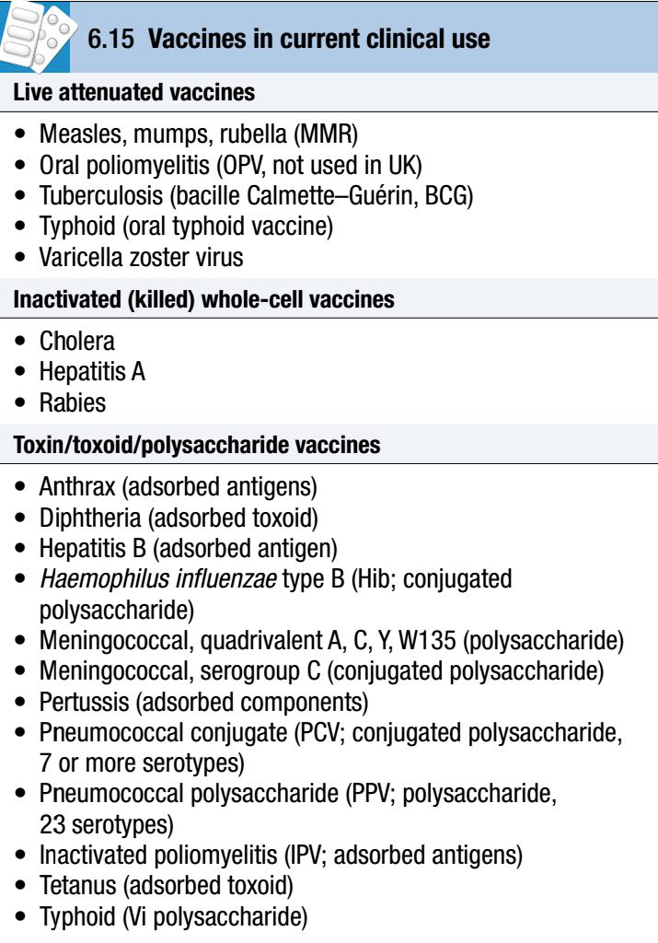
Types of vaccine:

Slide 50
Vaccines may be either live or inactivated.
Live vaccines contain organisms with attenuated (reduced) virulence, which result in a fully integrated T lymphocyte and humoral response and are therefore more immunogenic than inactivated vaccines.

Slide 51
However, the use of live vaccines in immunocompromised individuals requires careful consideration.
Inactivated vaccines consist of whole killed organisms or their antigenic components.

Slide 52
Vaccines consisting only of polysaccharides, such as pneumococcal polyvalent vaccine (PPV), are poor activators of T lymphocytes, and produce a short-lived antibody response without long-lasting memory.

Slide 53
Protein antigens are more immunogenic than polysaccharides.
Conjugation of a polysaccharide moiety to a protein, as in Haemophilus influenzae type B (Hib), Neisseria meningitidis serogroup C (MenC) and pneumococcal conjugate (PCV) vaccines, activates T lymphocytes, which results in a sustained response and immunological memory.

Slide 54
Toxoids are bacterial toxins that have been modified to reduce toxicity but maintain antigenicity.
Response can be improved further by co-administration with mildly pro-inflammatory adjuvants such as aluminium hydroxide.

Slide 55
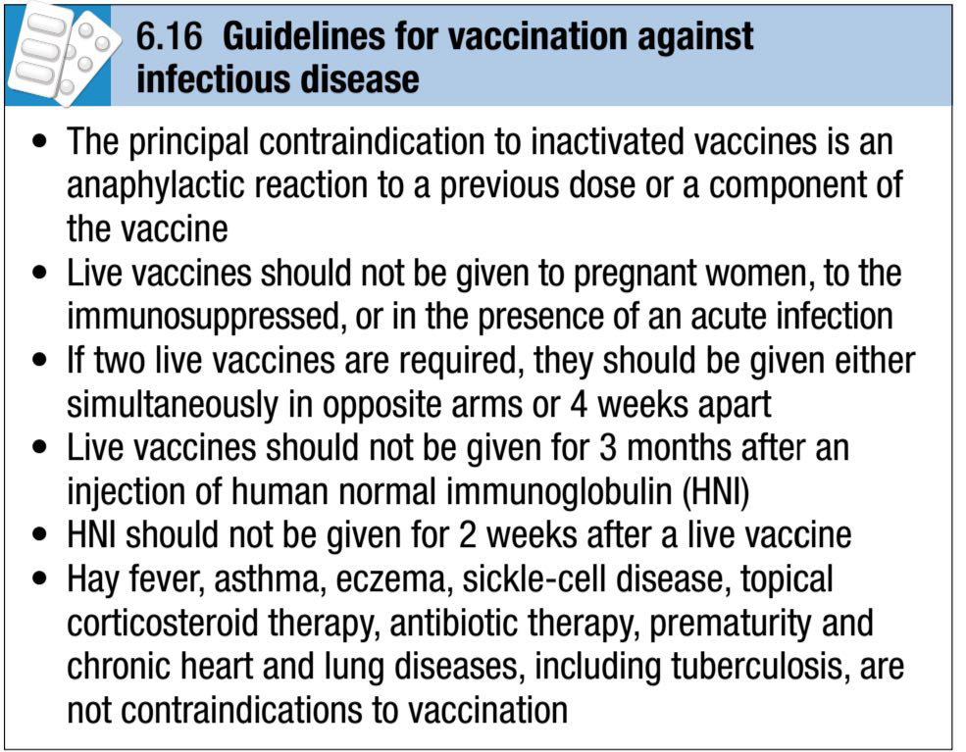
Use of vaccines:

Slide 56
Vaccination may be applied to entire populations (as in childhood vaccination schedules) or populations at specific risk through travel, occupation or other risk activities.
In ring vaccination, the population immediately surrounding a case or outbreak of infectious disease is vaccinated, to curtail further spread.

Slide 57
Vaccination becomes successful once the number of susceptible hosts in a population falls below the level required to sustain continued transmission of the target organism (herd immunity).
Naturally acquired smallpox was declared to have been eradicated world-wide in 1980 through mass vaccination.

Slide 58
In 1988 the WHO resolved to eradicate poliomyelitis by vaccination; the number of cases world-wide has since fallen from approximately 350 000 p.a. to 1651 in 2008.
Measles virus, however, is very infectious, and over 90% of a population needs to be vaccinated to achieve herd immunity.

Slide 59
A recent decline in the uptake of measles vaccination in the UK has been associated with increased prevalence of disease.
Recommended vaccination schedules vary between different countries.

Slide 60
THANK YOU

